Slide 1
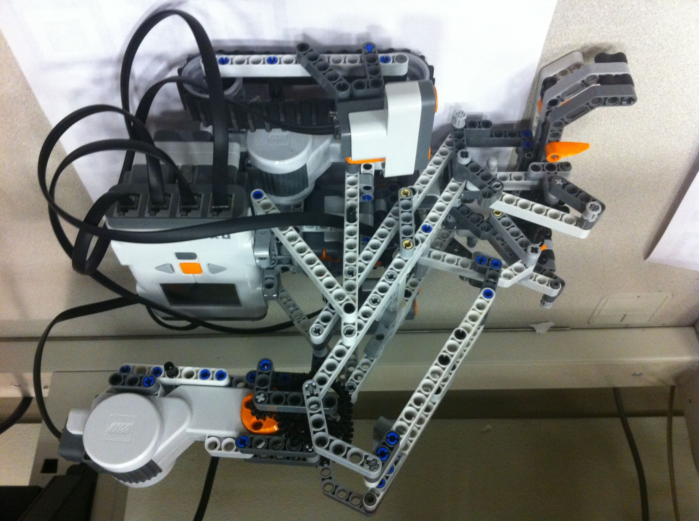
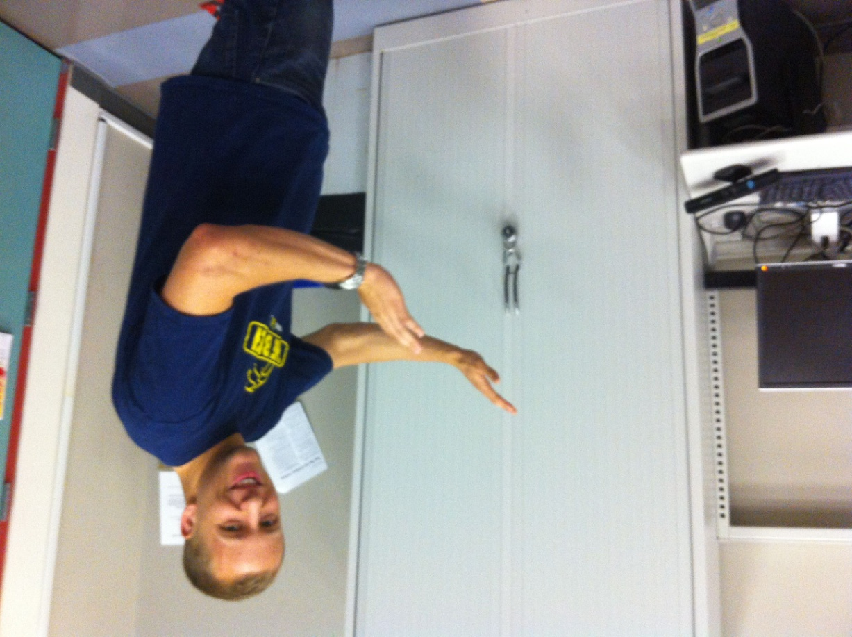
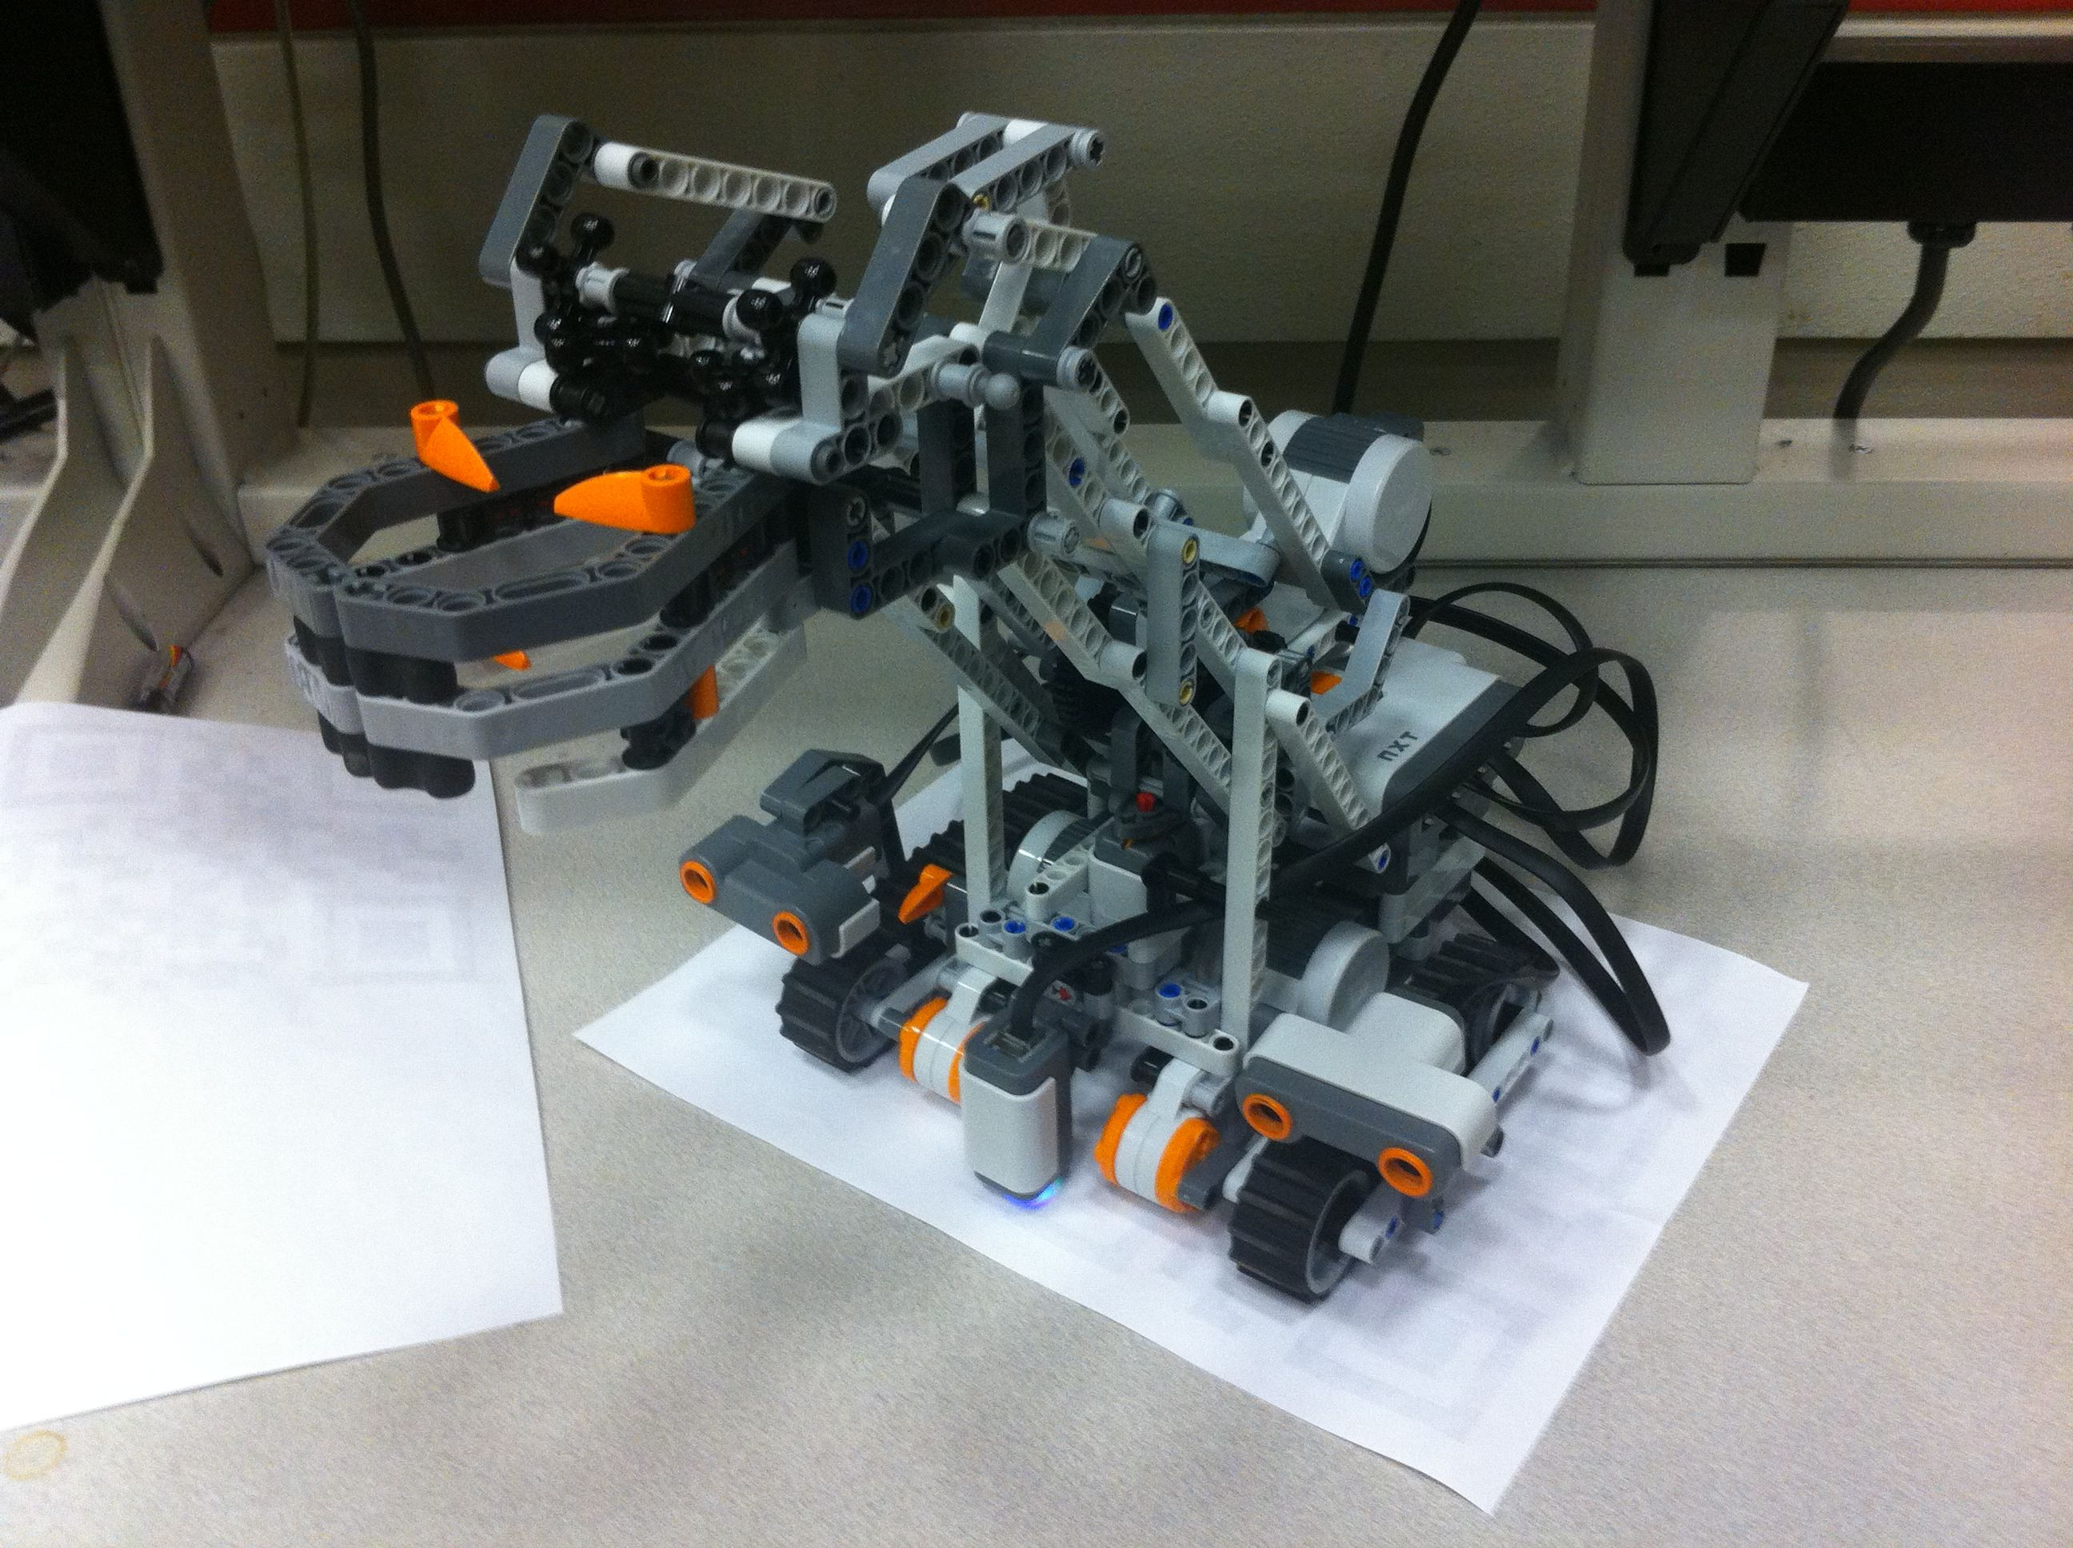
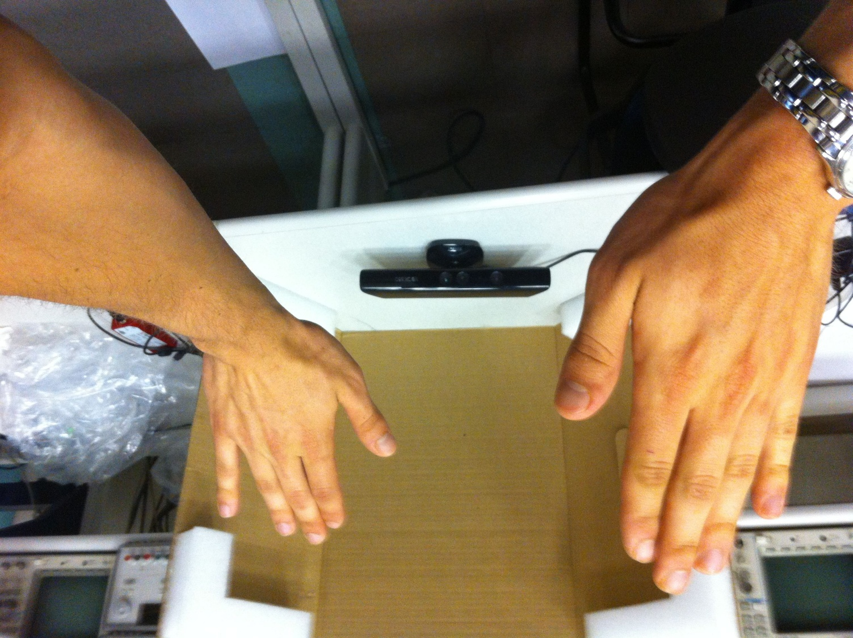
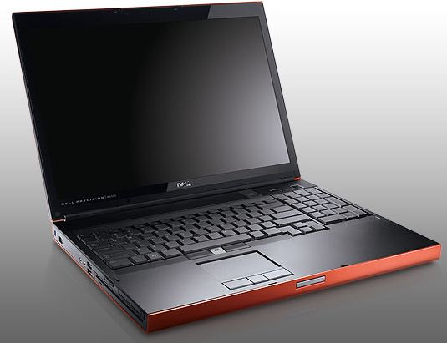
LEGO Mindstorms NXT Controlled by Kinect
Kinect
Software
Java code: OpenNI framework with PrimeSense’s NITE (for sensor drivers)
BlueCove Bluetooth Java library
Algorithm
Calibrating user arm length
Filtering sensor data
Normalizing sensor data to wheel speed
Creating larger range for 0 wheel speed
Difficulties
Creating fine user control of robot
Creating smooth motion for robot
Determining best control commands
LEGO Mindstorms NXT
Software
labVIEW Robotics
Algorithm
Once Bluetooth message is received, determine output power level for left, right and claw motors.
Decay value of user inputs and store in registers. If no further user input, use stored values and decay further. Ensures that NXT stops if Kinect gets disconnected.
Difficulties
Adjusting speed of NXT based on ultrasonic reading, user input and claw position.
Use two ultrasonic sensors in body of robot.
iRobot Create
Software
LabVIEW Statecharts
Web Service vs. UDP Shared Variable
Algorithm
Obstacle Avoidance (similar to lab)
Difficulties
LabVIEW error on deploy
UDP
Shared Variable
Large Statechart
Achievements
Accurate control of LEGO Mindstorms NXT via Kinect controls
What more could be done?
Control iRobot Create with same Kinect controls
Obstacle avoidance using many more sensors (LIDAR, Vision with camera)
Better calibration for multiple users
More gesture controls
David Jimenez
David Howard
Joe Crnkovich
Travis Langner
Evan Layman

Slide 2
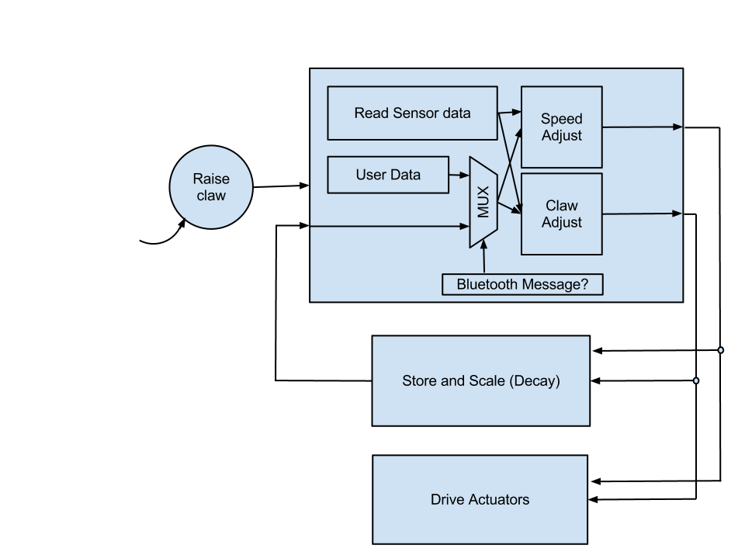
NXT Control

Slide 3
Conclusion
Achievements
Accurate control of LEGO Mindstorms NXT via Kinect controls
What more could be done?
Control iRobot Create with same Kinect controls
Obstacle avoidance using many more sensors (LIDAR, Vision with camera)
Better calibration for multiple users
More gesture controls

